Slide 1

How testing is conducted
Testing is based on external expectations - Internal behavior of the application is unknown.
Testing is done on the basis of high-level database diagrams and data flow diagramsInternal workings are fully known and the tester can design test data accordingly..
Internal workings are fully known and the tester can design test data accordingly.

Slide 2
Scope of testing
The scope of a test defines what areas of a customer's product are supposed to get tested, what functionalities to focus on, what bug types the customer is interested in, and what areas or features should not be tested by any means.
Factors influencing the scope of testing
Planning. Planning in software testing is essential. ...
Time. As there are some projects where time pressure takes place, it is important to be careful with test estimation. ...
Size & Complexity. ...
Documentation. ...
Skills. ...
Team interaction. ...
Methodology. ...
Trends.

Slide 3
Risk Based Testing
"Tomorrow problems are today's risk." Hence, a clear definition of a "risk" is a problem that could cause some loss or threaten the progress of the project, but which has not happened yet.
Some riskbased testing techniques are given below: Product Risk Management (PRMa) Pragmatic Risk Analysis and Management (PRAM) Systematic Software Testing (SST)
Risk based testing is basically a testing done for the project based on risks. Risk based testing uses risk to prioritize and emphasize the appropriate tests during test execution. In simple terms – Risk is the probability of occurrence of an undesirable outcome. This outcome is also associated with an impact.

Slide 4
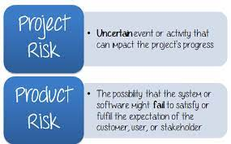

Slide 5
Needs of Independent testing
Finds out more defects as compared to other testers working inside the programming team.
Unique side assumptions and ideas of independent testers result in identifying hidden defects.
The independent testers are unbiased.
Cost-effective as it has a separate budget, which helps in tracking money spent on training, testing tools, equipment.
Provides improved Software Quality.
Supplies more Experienced and skilled power.
One can easily switch between manual and automation testing using independent testing due to being more flexible.
Reduces time to market by providing access to expert skills in test automation skills ensures faster testing cycles.

Slide 6
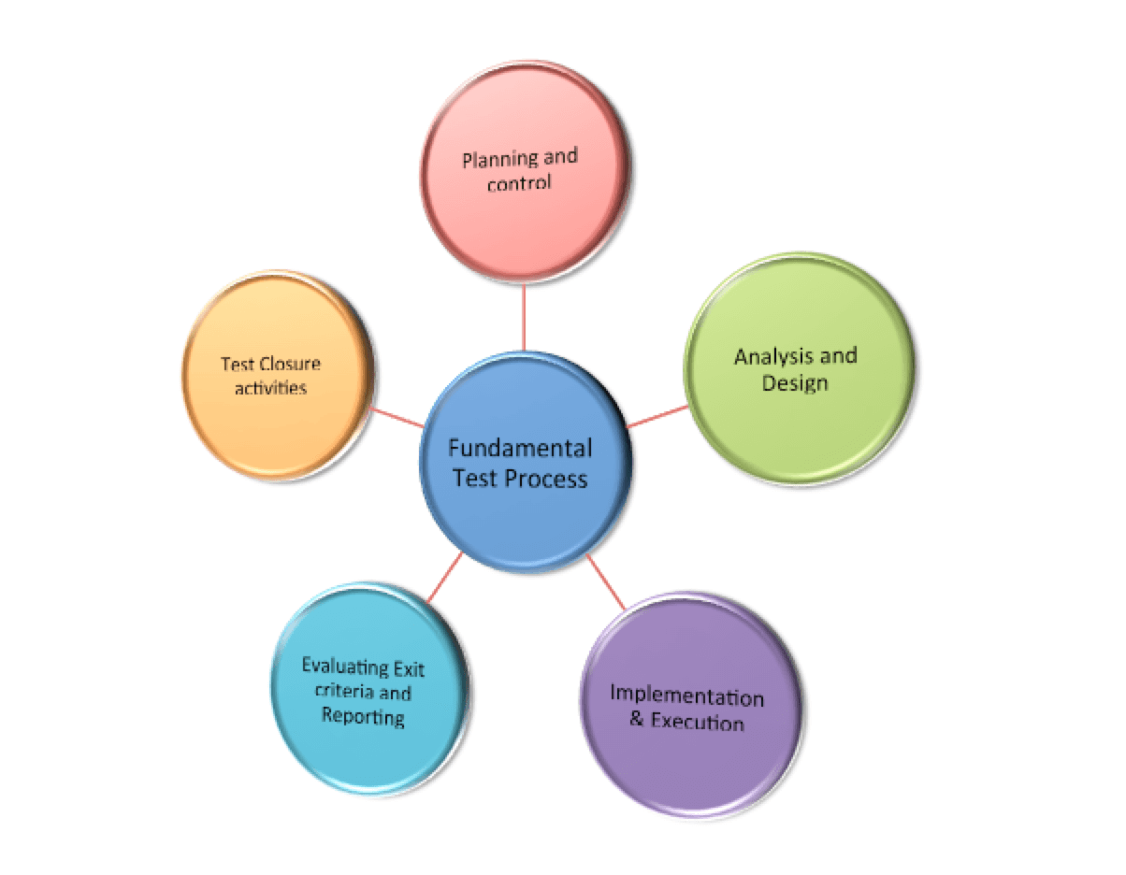
Activities in fundamental test process

Slide 7
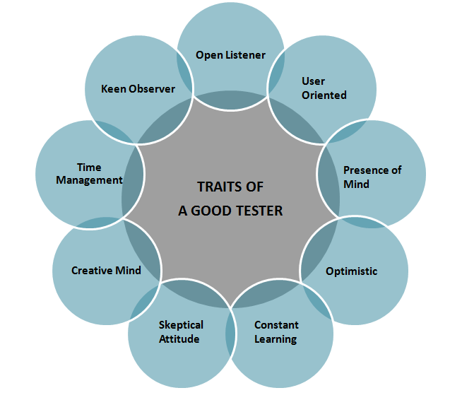
Attributes Of a Good Tester

Slide 8
Psychology for testing
In software testing, psychology plays an extremely important role. It is one of those factors that stays behind the scene, but has a great impact of the end result. Categorized into three sections, the psychology of testing enables smooth testing as well as makes the process hassle free. It is mainly dependent on the mindset of the developers and testers, as well as the quality of communication between them. Moreover, the psychology of testing improves mutual understanding among team members and helps them work towards a common goal.
The three sections of psychology of testing are:
Mindset of Developers and Testers.
Communication in a Constructive Manner.
Test Independence.

Slide 9
Code of Ethics for Tester
Software engineers shall commit themselves to making the analysis, specification , design, development, testing and maintenance of software a beneficial and respected profession. In accordance with their commitment to the health, safety and welfare of the public, software engineers shall adhere to the following eight principles:
Product
Public
Judgment
Client and employer
Management
Profession
Self
colleagues

Slide 10

Limitations of software testing
Poor testing process
Future requirements not anticipated
Inadequate time
Inadequate test data
Software changes inadequately test
You can’t test program completely
You can’t test every path
You can’t test every valid path
You can’t test every invalid path

Slide 11

THANK YOU

